Slide 1
Contents
Background
1 Qubits
2 Gates
3 Bell State
Challenge
4 IBM Quantum Composer
5 Prompt
6 Example
Resources
9 Learning and Tools

Slide 2
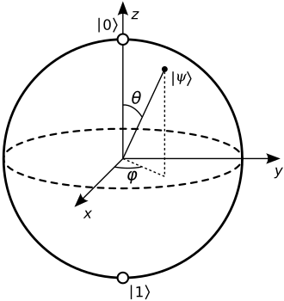
Bloch Sphere
-Measurement Axis
-Phase
https://bloch.kherb.io/

Slide 3
Some quantum gates
X-gate: Rotates about the x-axis
From state 1 -> state 0
Y-gate: Rotates about the y-axis
Z-gate: Rotates about the z-axis
Hadamard gate: Puts qubit into a superposition
CNOT gate: Entangles 2 qubits

Slide 4
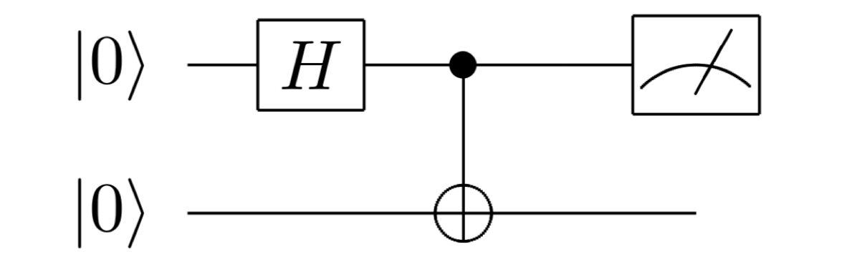
Bell State

Slide 5
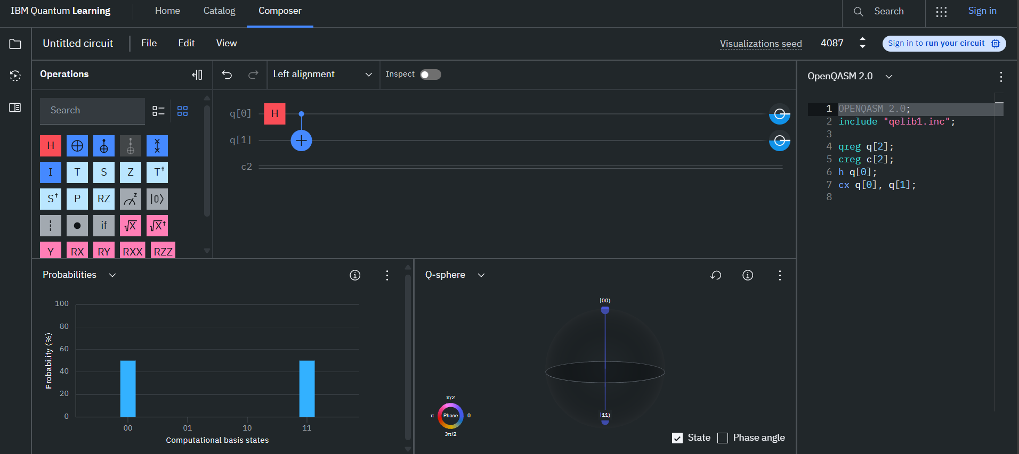
IBM’s Quantum Composer
INTRODUCTIONS
https://quantum.ibm.com/composer/files/new

Slide 6
Prompt
Your challenge is as follows. Create an interactive game, logic puzzles, challenge or anything you can think of, using quantum computing, the more creative the better.
The judging criteria is as follows: 50% for your idea, 50% for your execution.
Reminder - No previous quantum knowledge is expected for this challenge for a reason, if your game is only understandable to someone with extensive quantum knowledge, it's not a very good game. The players of your game should be able to pick up the game quickly, and learn about elements of quantum computing as they go.
Link: https://github.com/SamDyer22/KHE2025Quantum/blob/main/KHEQuantumTrack.ipynb

Slide 7
Resources
https://www.youtube.com/watch?v=c1beJIg8lRs
https://docs.quantum.ibm.com/

